Slide 1

How can predictive modelling techniques be used to accurately forecast customer churn in a banking dataset?
What algorithms accurately forecast customer churn in a banking dataset.

Slide 2
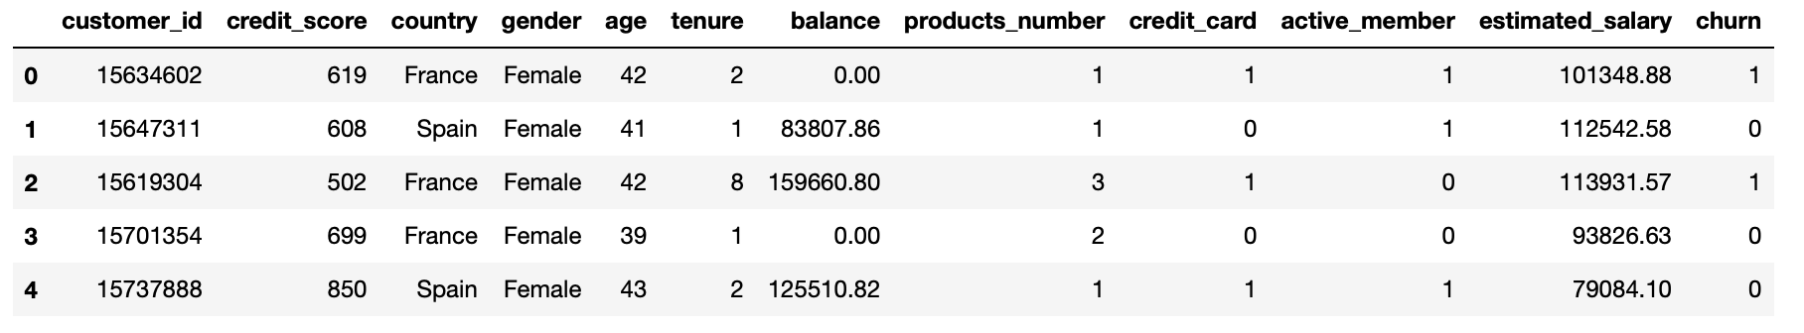
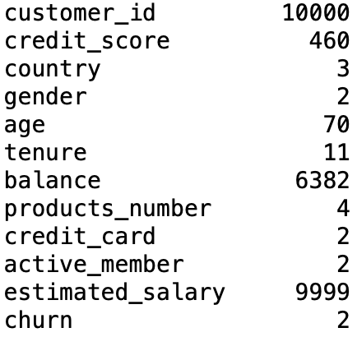

The Dataset
Head of Dataset
No of unique values
Shape of Dataset
Range of different discrete and continuous values
Large dataset with 10,000 values
10.0 usability score on Kaggle with over 14,000 downloads
https://www.kaggle.com/datasets/gauravtopre/bank-customer-churn-dataset/data

Slide 3
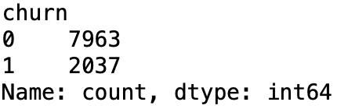
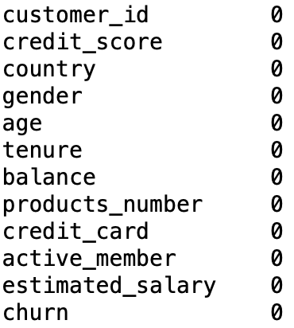
Data Preparation and Cleaning
Churn amount
Amount of null values
Data is already clean
Amount of people that churned is imbalanced so will need to rebalance
scscscs

Slide 4
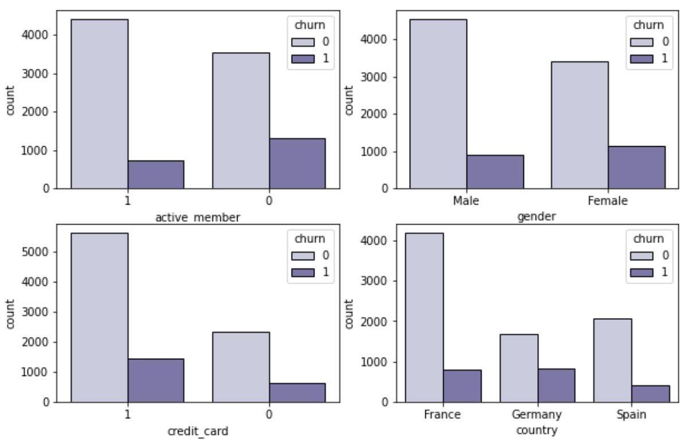
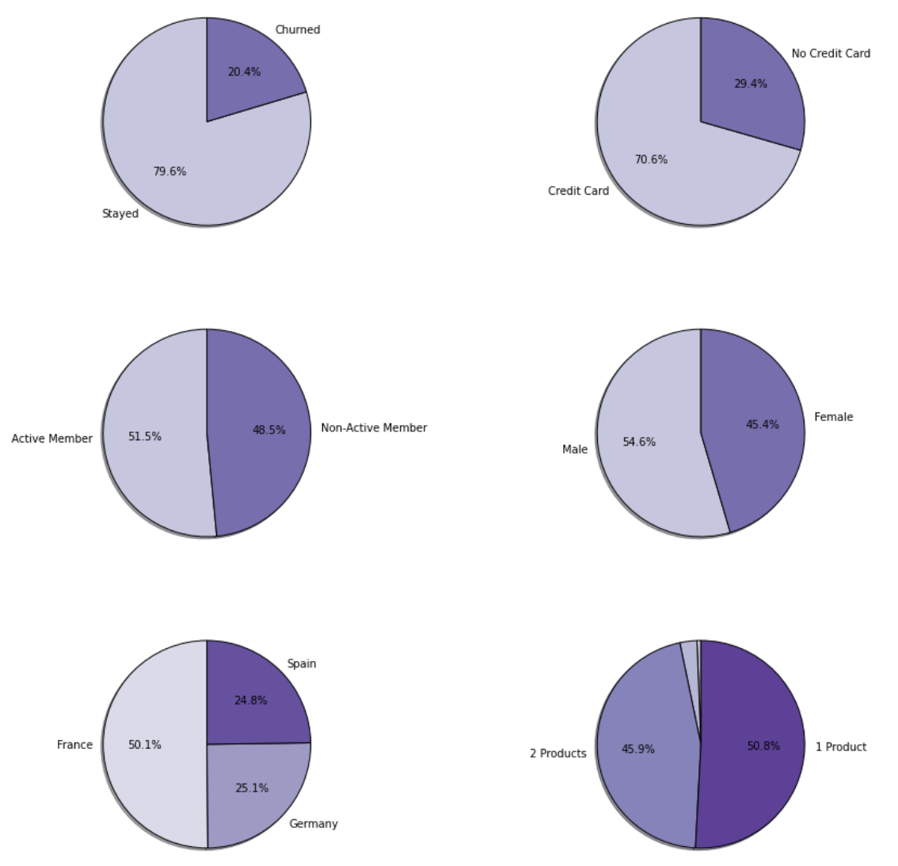
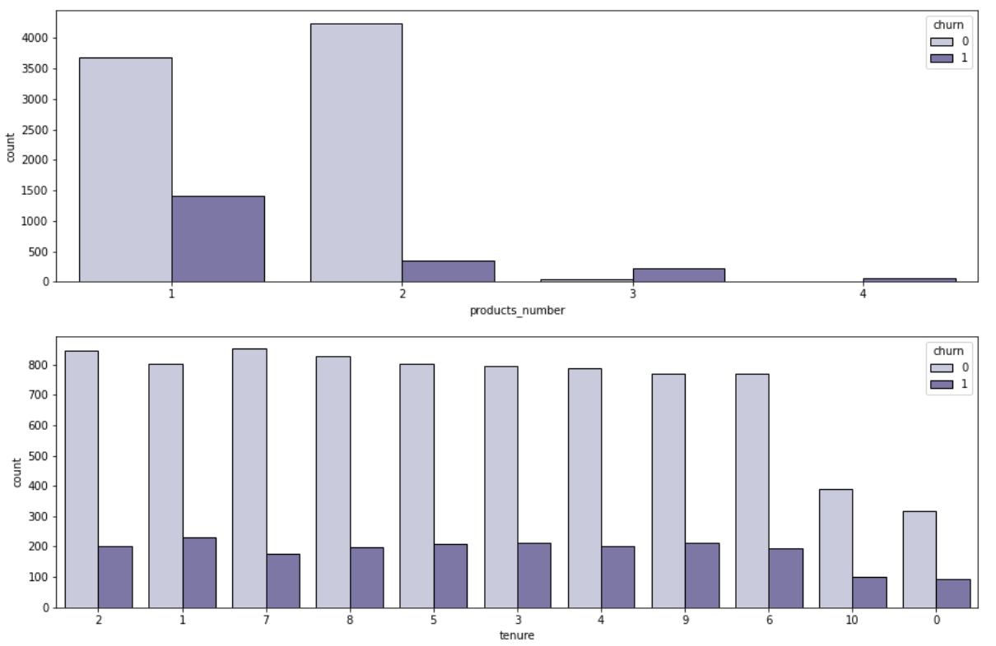
Discrete Data
Churn and credit card are imbalanced
Germany has a relatively high churn rate
Churn for products number = 2 is very low
Females have a higher churn rate then males

Slide 5
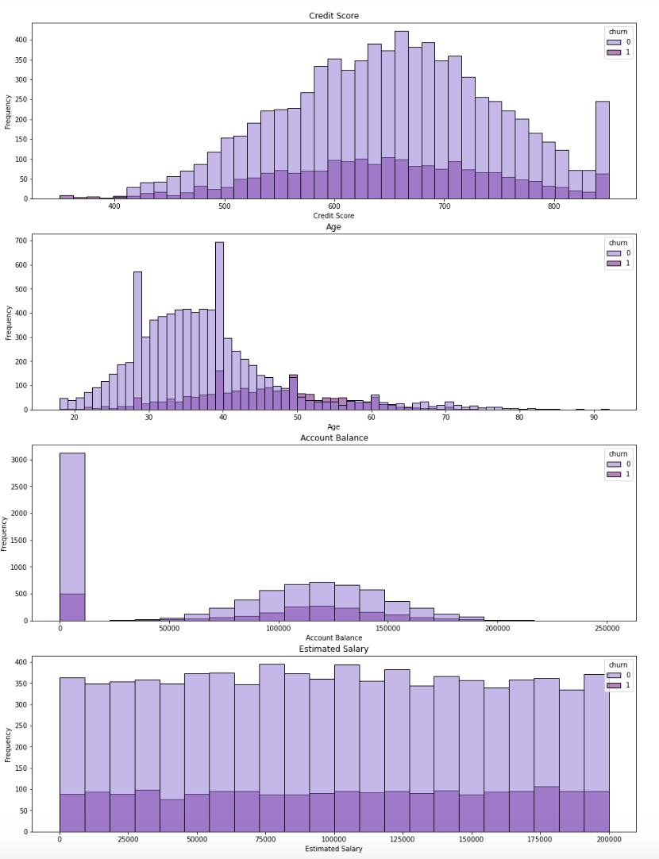
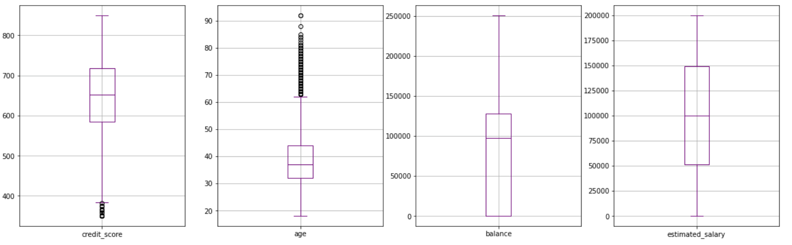
Continuous Data
As age increases churn rate increases
Age has a lot of anomalies
Credit score has some anomalies

Slide 6
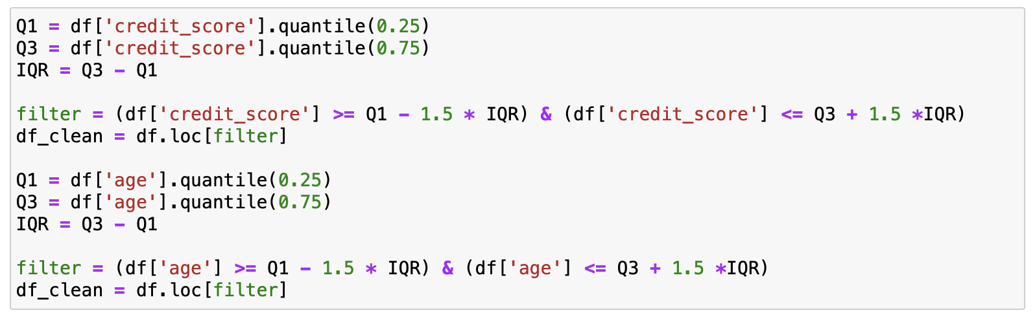

Anomalies
Age has many anomalies
Credit score has anomalies
Code has removed 359 entries from the dataset
Removing anomalies
Shape of clean dataset

Slide 7
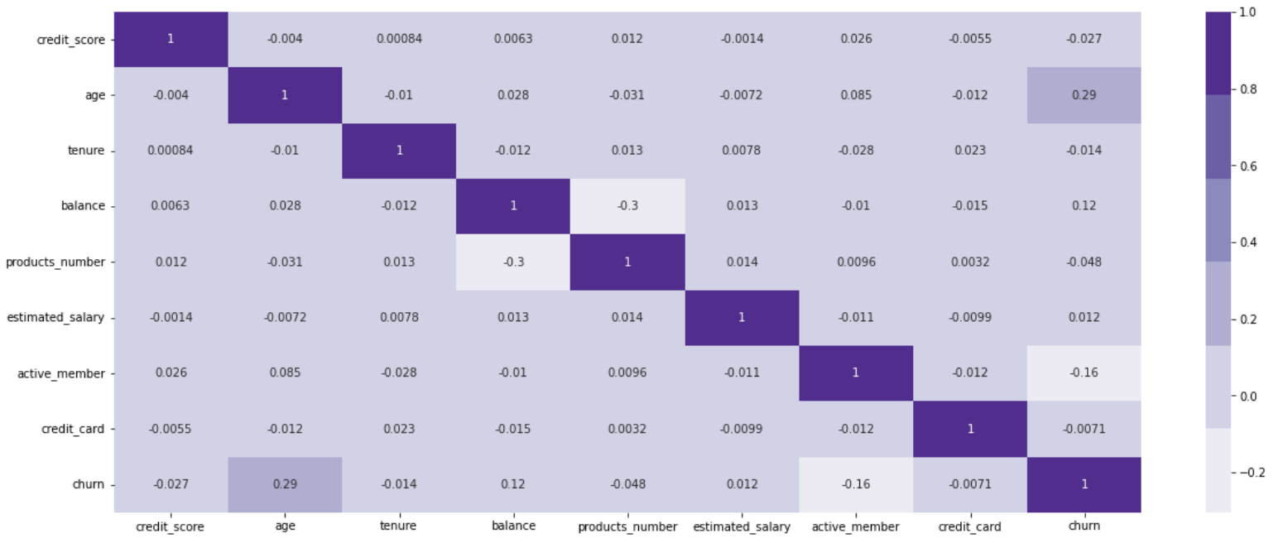
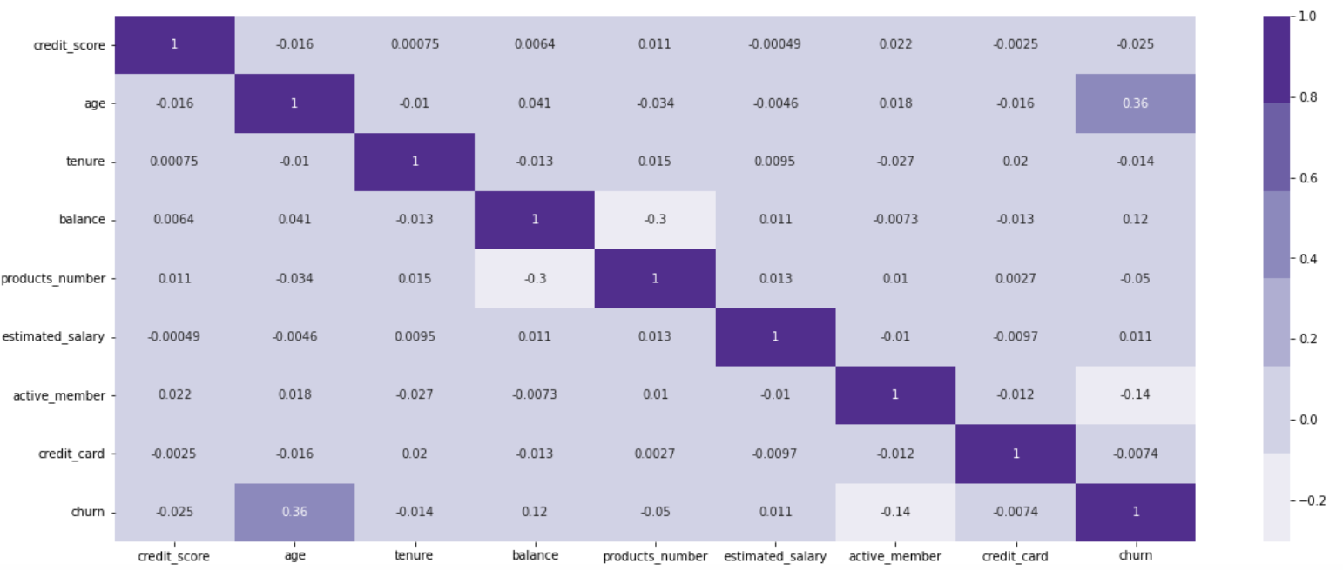
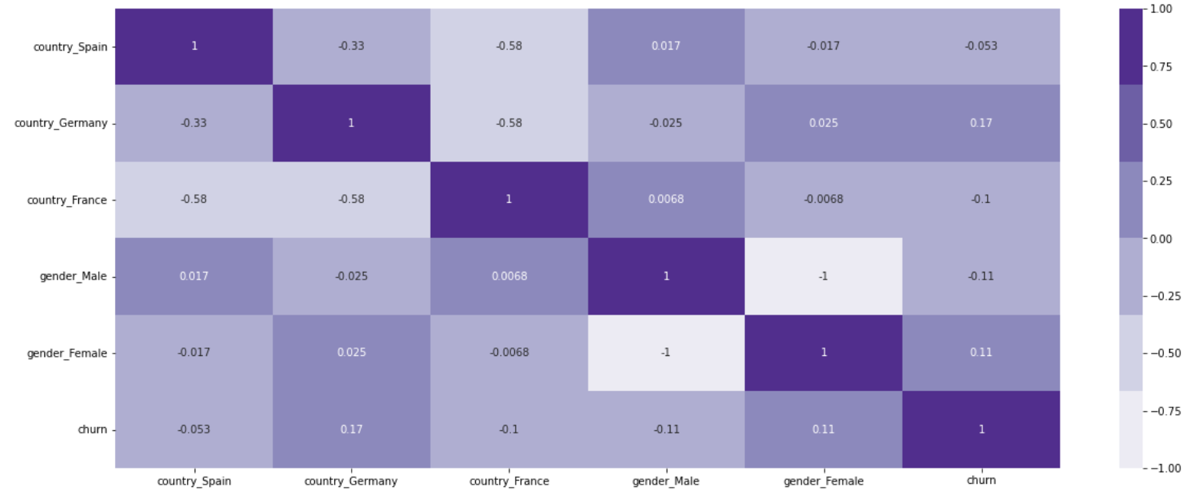
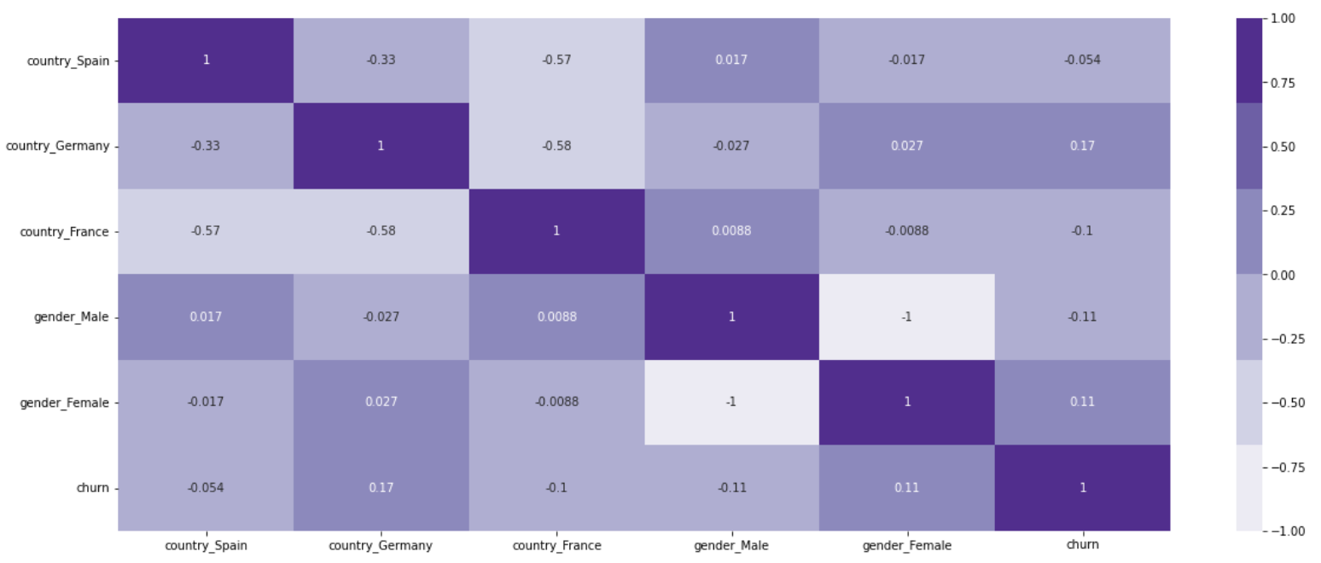
Correlation Heatmaps
Original
Clean
Use the clean data to build the model

Slide 8
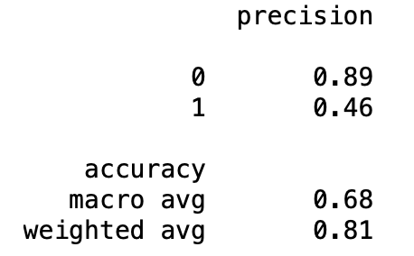
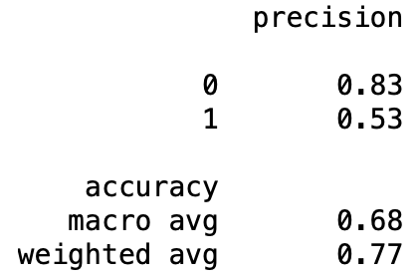
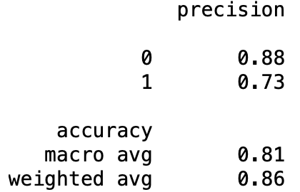
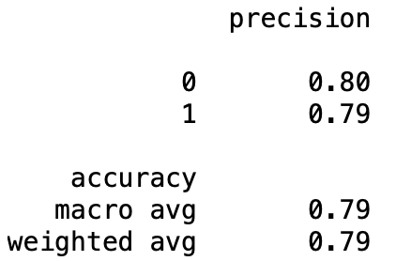
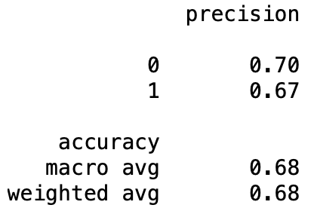
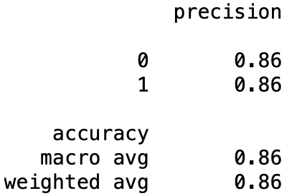
The Model
Logistic Regression
Decision Tree
Random Forest
Rebalanced
Random Forest has the best precision overall

Slide 9
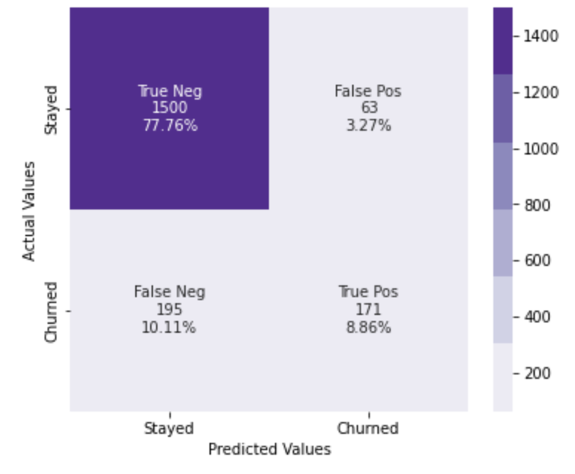
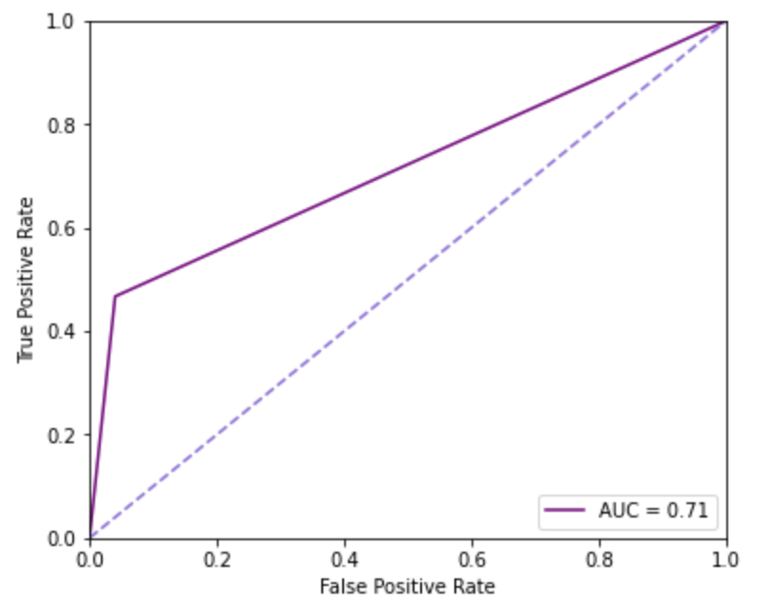
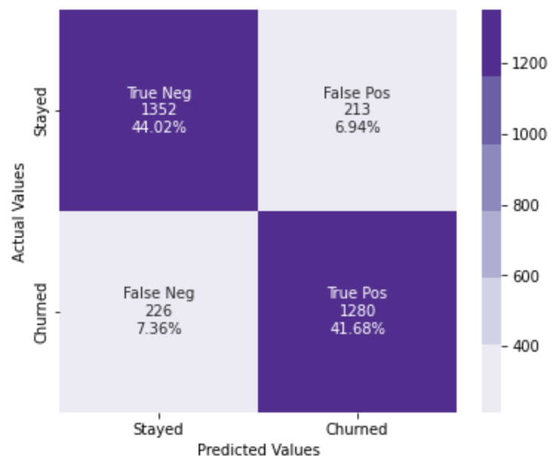
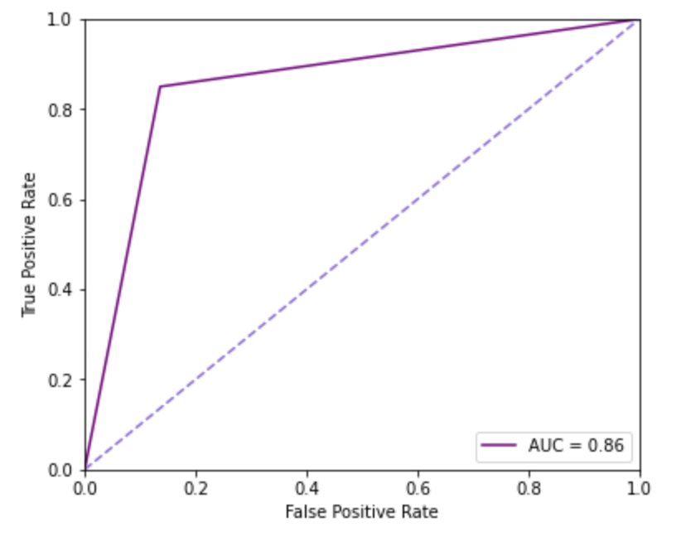
Analyzing the results
Original Random Forest Classifier
Rebalanced Random Forest Classifier
Confusion matrix shows a very high false negative and very low false positive in respect to their counterparts
ROC curve is good but could be improved by using rebalancing
Confusion matrix shows data is more balanced
ROC curve shows an AUC of 0.86 which is greater than before the rebalance

